Slide 1
The Current State of Agility
Notes:
Author: Ahmed Hosni
1

Slide 2


Slide 3
Cargo Cult Agile
Notes:
https://en.wikipedia.org/wiki/Cargo_cult
3

Slide 4

Cargo Cult?
4
Notes:
http://calteches.library.caltech.edu/3043/1/CargoCult.pdf

Slide 5
What is a Cargo Cult?
Religious practice focused on obtaining goods (cargo) by means of magic and rituals.
Based on irrational beliefs and behavior.
Used as a metaphor for many fields (politics, economics, journalism…).
Cargo Cults have repeatedly been used as a metaphor for software development and Agile practices…
… usually describing “doing Agile but not being Agile” kind of behavior
5
Notes:
- Steve McConnell http://bit.ly/5voCM4
Maxx Daymond http://bit.ly/gZ57Kk
James Shore http://bit.ly/aek5r9

Slide 6
The habits of Cargo Cult people Let’s take the “coach” as an example
Notes:
Author: Ahmed Hosni
6

Slide 7
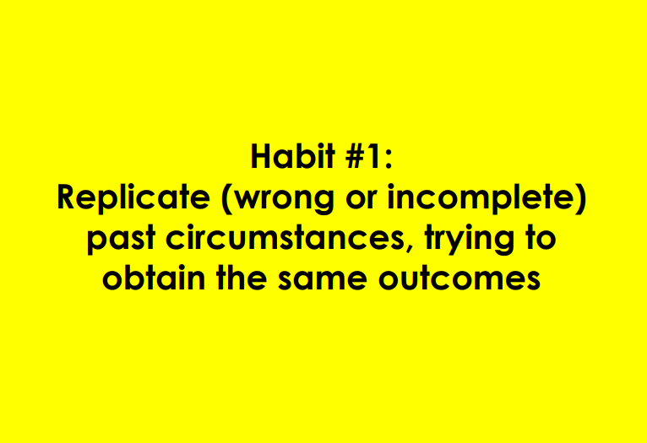
7

Slide 8
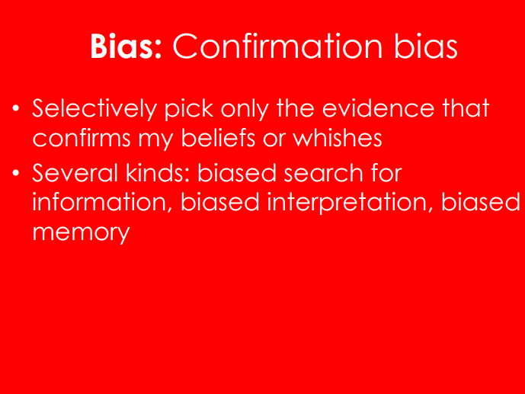
8

Slide 9
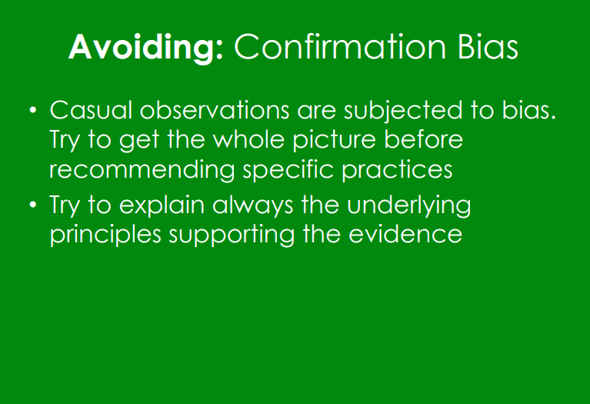
9

Slide 10
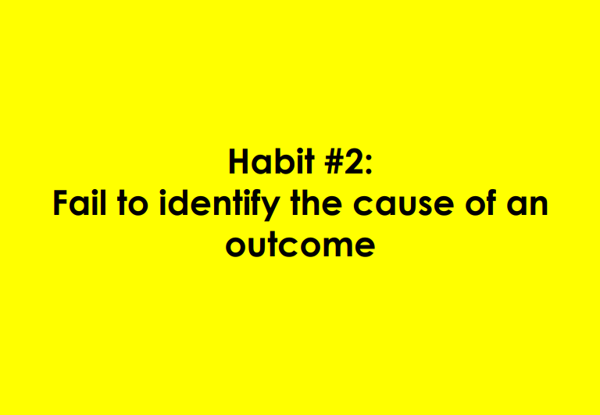
10

Slide 11
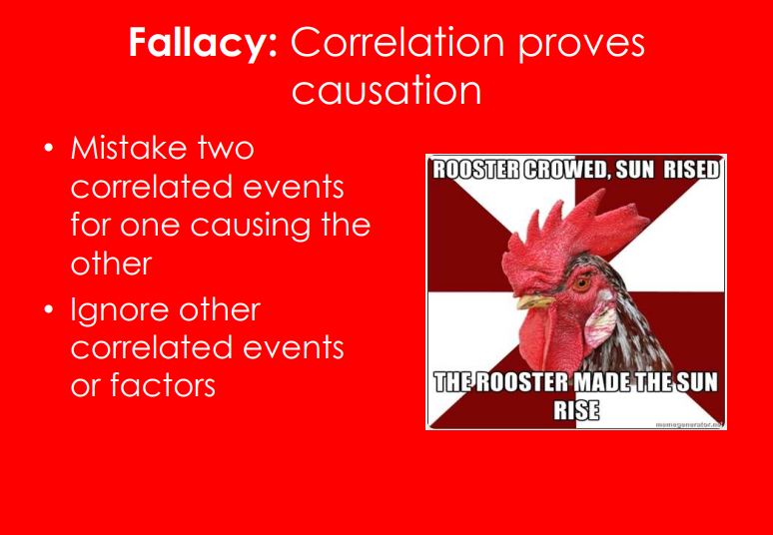
11

Slide 12
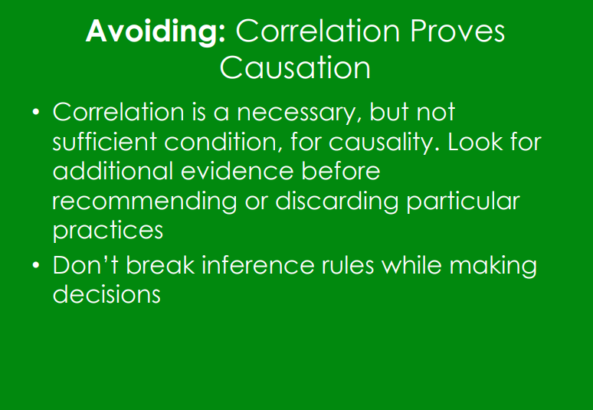
12

Slide 13
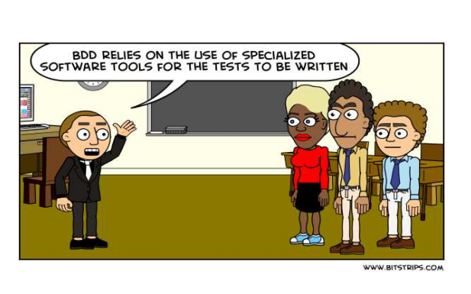
13

Slide 14
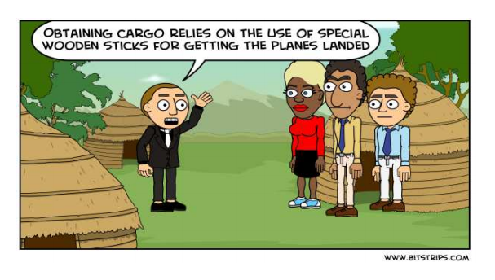
14

Slide 15
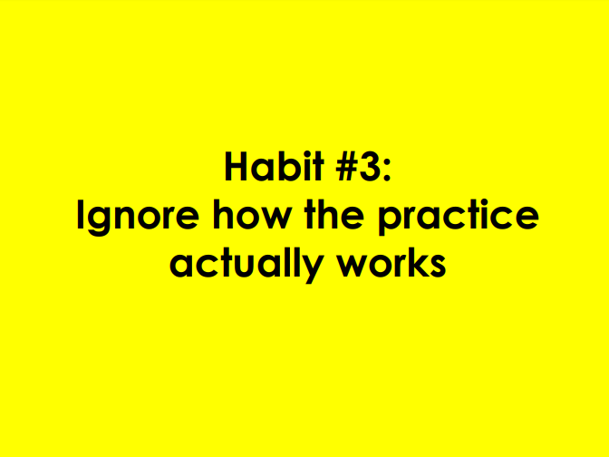
15

Slide 16
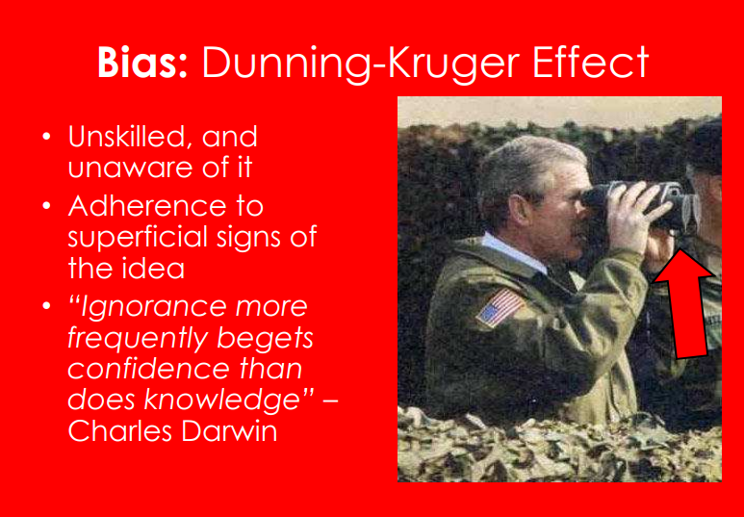
16

Slide 17
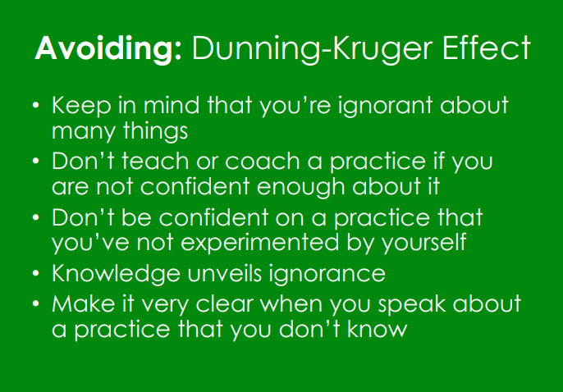
17

Slide 18
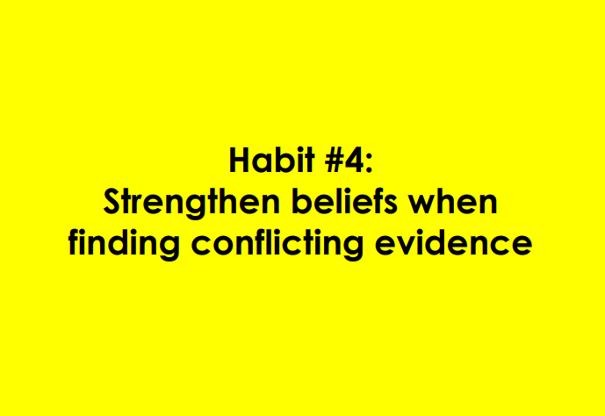
18

Slide 19
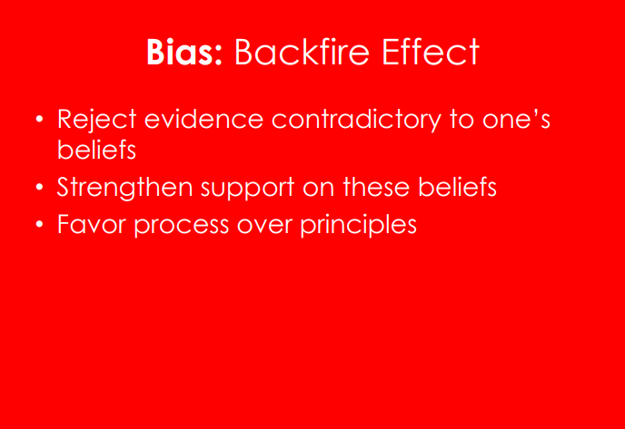
19

Slide 20
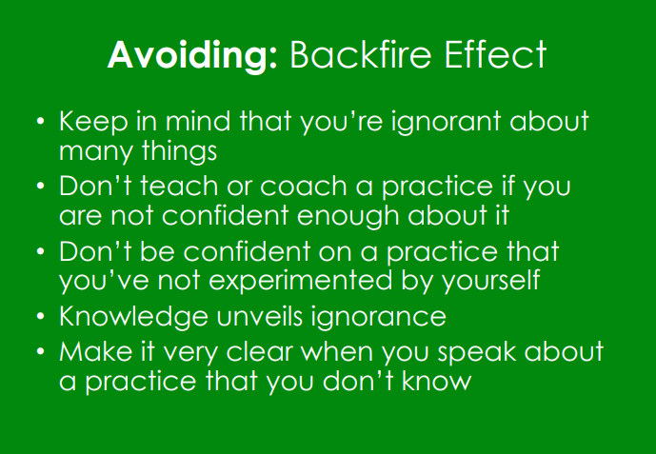
20

Slide 21
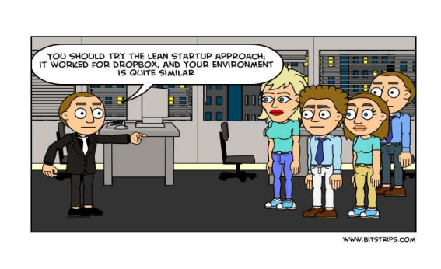
21

Slide 22
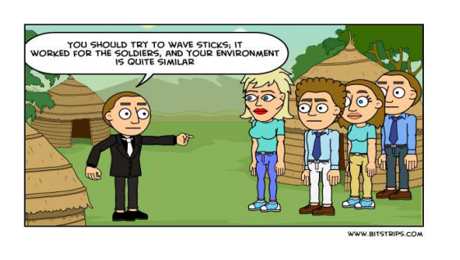
22

Slide 23
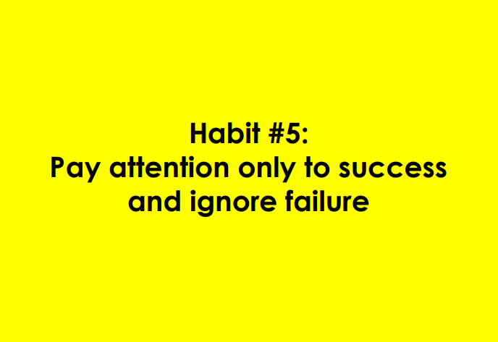
23

Slide 24
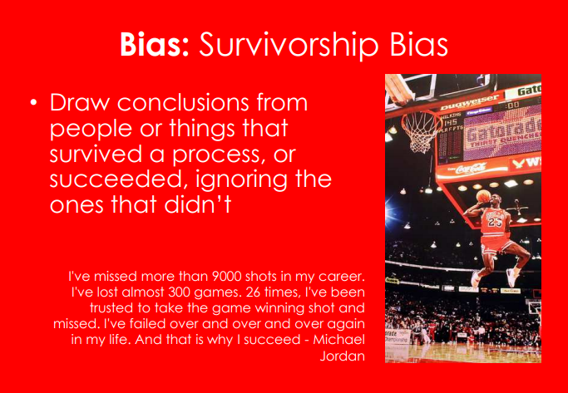
24

Slide 25
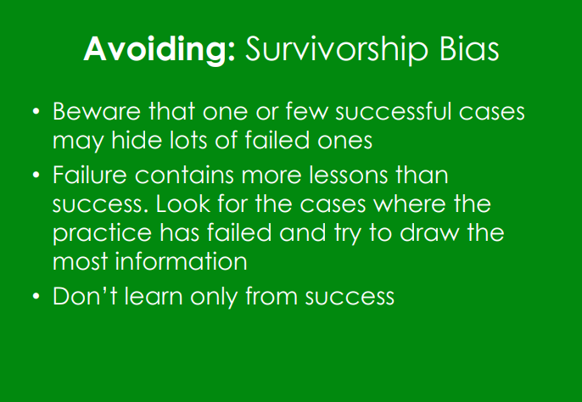
25

Slide 26
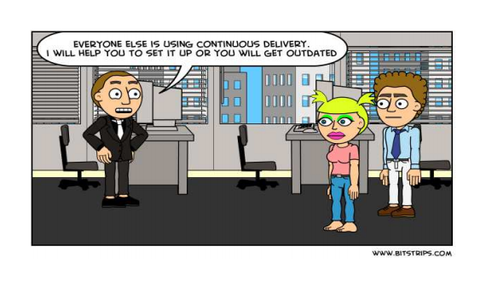
26

Slide 27
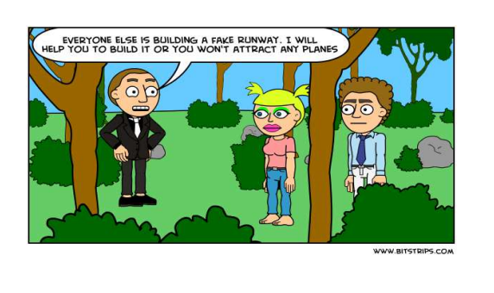
27

Slide 28
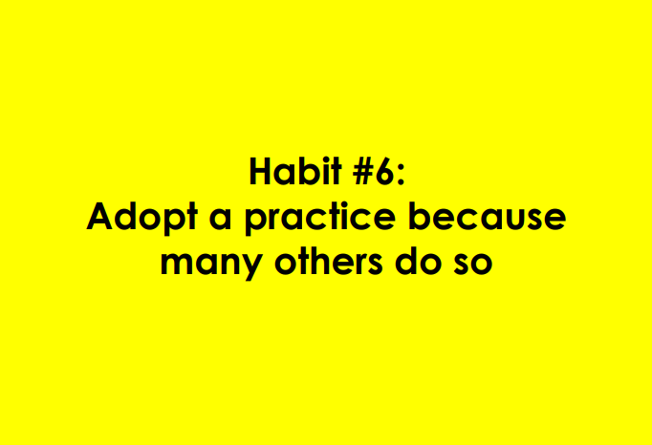
28

Slide 29
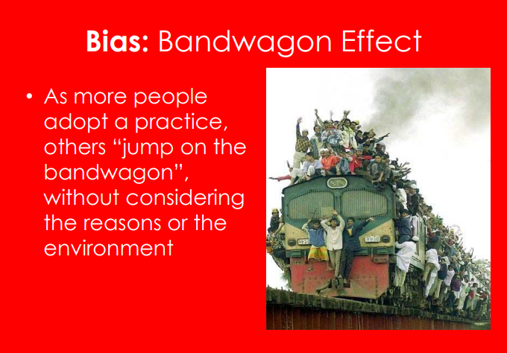
29

Slide 30
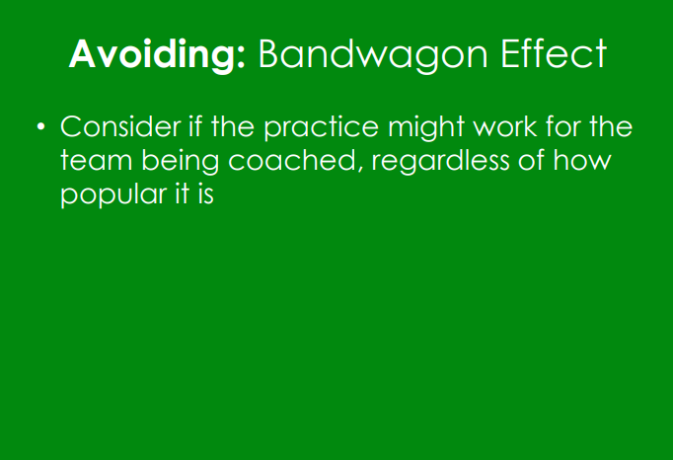
30

Slide 31
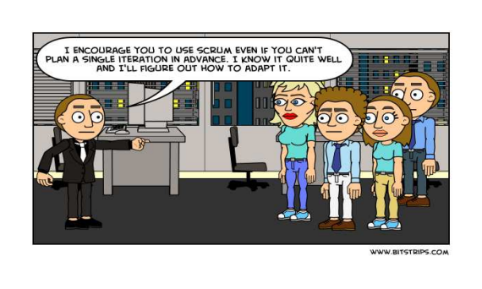
31

Slide 32
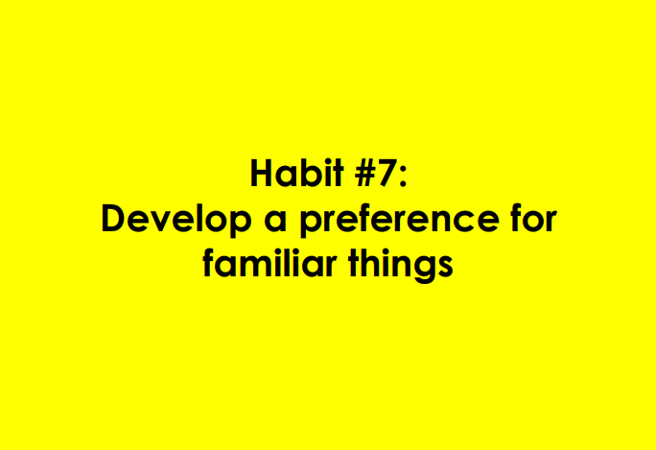
32

Slide 33
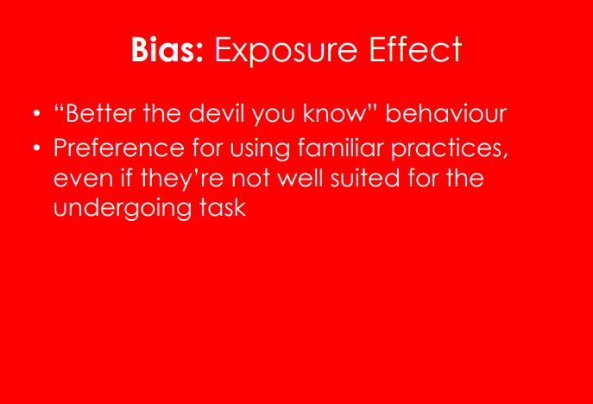
33

Slide 34
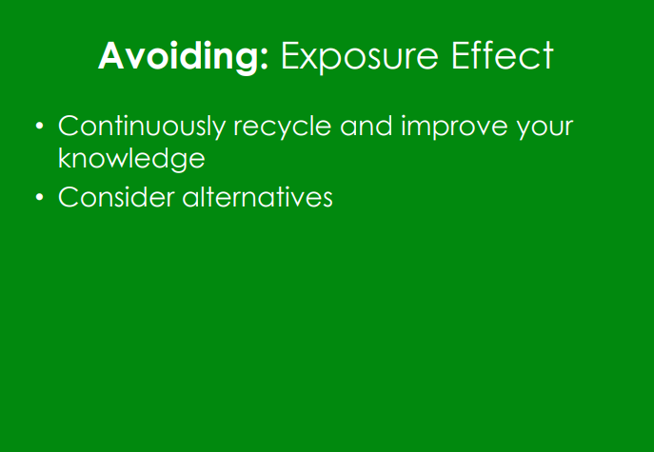
34

Slide 35
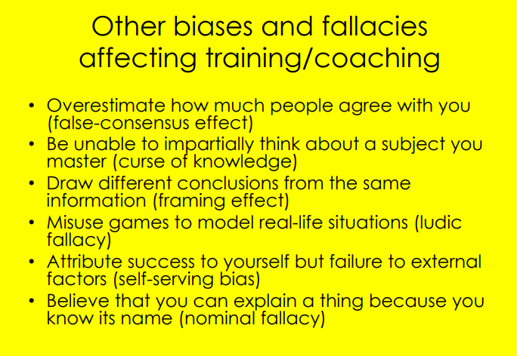
35

Slide 36
The poll
Notes:
https://fr.surveymonkey.com/r/3GBFG7C
36

Slide 37
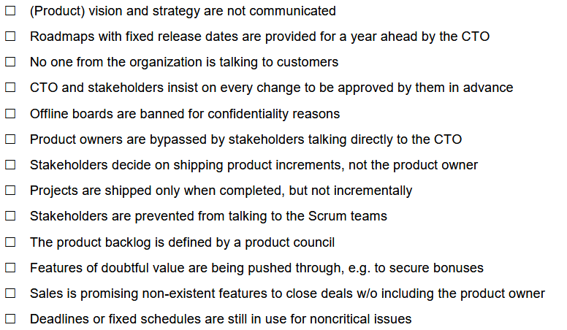
Please check all boxes that apply and return the form:
37

Slide 38
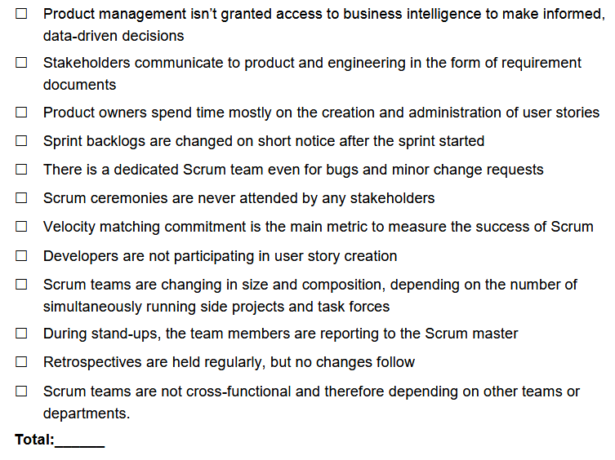
Please check all boxes that apply and return the form:
38

Slide 39
Interpretation

Slide 40
Let’s build an opinion
0–2 boxes | I’d like to talk to you how you managed to do that. You probably don’t need this training!
3–5 boxes | Well done! You’re on a good way.
6–8 boxes | There is room for improvement. Lot’s of it
9–14 boxes | If you haven’t very recently embarked on your agile voyage, then it is time to change your approach
15–20 boxes | Okay, start over with agile! It is not working in the current set-up within your organization
21–25 boxes | You either haven’t started going agile yet. Or you are sugar-coating command-and-control structures to look “agile”. It won’t work, by the way.
40

Slide 41
Questions?

